Slide 1
Planar Graphs & Graph Coloring
Course Code: 00090
Course Title: Discrete Mathematics
Dept. of Computer Science
Faculty of Science and Technology
Lecturer No: | 19 | Week No: | 11 | Semester: | Summer 21-22
Lecturer: | Md. Mahmudur Rahman (mahmudur@aiub.edu)

Slide 2
Lecture Outline
8.7 Planar Graphs
8.8 Graph Coloring

Slide 3
Objectives and Outcomes
Objectives: To understand the terms planar graph, graph coloring, chromatic number, Euler formula; to determine whether a graph is planar; to determine the chromatic number of a graph, to understand applications of graph coloring.
Outcomes: The students are expected to be able to explain the terms planar graph, graph coloring, chromatic number, Euler formula; be able to determine whether a graph is planar; be able to determine the chromatic number of a graph, be able to solve the problem of Scheduling Final Exams at a university using graph coloring model.

Slide 4
Planar Graphs
A graph is called planar if it can be drawn in the plane without any edges crossing.
Such a drawing is called a planar representation of the graph
Note: A graph may be planar even if it is usually drawn with crossings, since it may be possible to draw it in another way without crossings.

Slide 5
Example 1
Example 1: Is K₄ (shown in Figure 2 with two edges crossing) planar?
Solution: K₄ is planar because it can be drawn without crossings, as shown in Figure 3
Figure 2
Figure 3

Slide 6
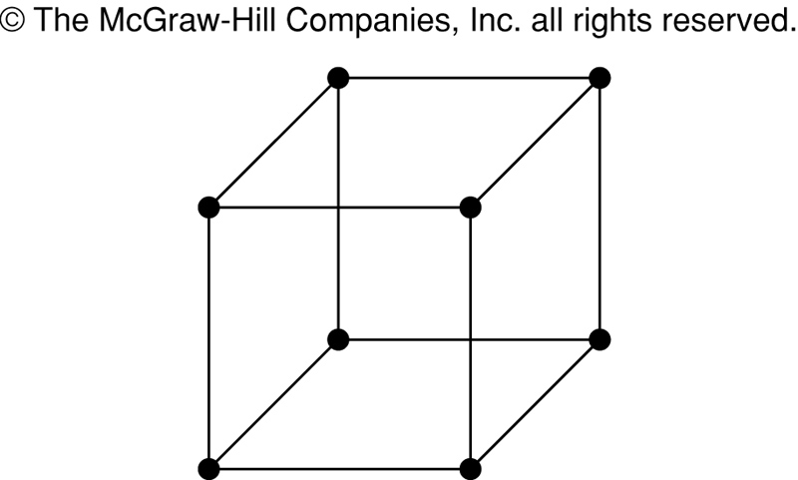
Example 2
Example 2: Is Q₃ (shown in Figure 4) planar?
Figure 4

Slide 7
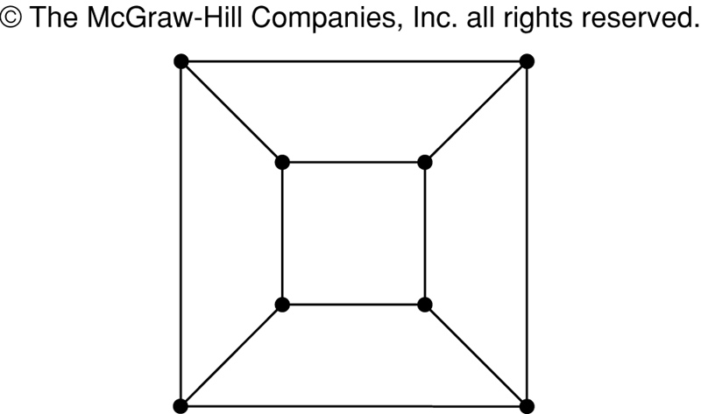
Solution of Example 2
Solution: Q₃ is planar, because it can be drawn without any edges crossing, as shown in Figure 5.
Figure 4
Figure 5

Slide 8
Example 3
Example 3: Is K_{3,3}, shown in Figure 6, planar?
v₁ v₂ v₃
v₄ v₅ v₆
Figure 6

Slide 9
Solution of Example 3
In any planar representation of K_{3,3}, vertex v₁ must be connected to both v₄ and v₅, and v₂ also must be connected to both v₄ and v₅.
v₁ v₂ v₃
v₄ v₅ v₆

Slide 10
Solution of Example 3 (cont.)
The four edges {v₁, v₄}, {v₄, v₂}, {v₂, v₅}, {v₅, v₁} form a closed curve that splits the plane into two regions, R₁ and R₂,as shown in Figure 7(a).
v₁ v₅
R₂ R₁ Figure 7 (a)
v₄ v₂

Slide 11
Solution of Example 3 (cont.)
Next, we note that v₃ must be in either R₁ or R₂.
When v₃ is in R₂, then the edges {v₃, v₄} and {v₃, v₅} separate R₂ into two sub-regions, R₂₁ and R₂₂.
v₁ v₅ v₁ v₅
R₂₁
R₂ R₁ → v₃
R₂₂
v₄ v₂ v₄ v₂
R₁

Slide 12
Solution of Example 3 (cont.)
Now there is no way to place vertex v₆ without forcing a crossing:
If v₆ is in R₁, then {v₆, v₃} must cross an edge
If v₆ is in R₂₁, then {v₆, v₂} must cross an edge
If v₆ is in R₂₂, then {v₆, v₁} must cross an edge
v₁ v₅
R₂₁
v₃ R₁
R₂₂
v₄ v₂

Slide 13
Solution of Example 3 (cont.)
When v₃ is in R₁, then the edges {v₃, v₄} and {v₄, v₅} separate R₁ into two sub-regions,
R₁₁ and R₁₂.
v₁ v₅
R₁₁
R₂ R₁₂ v₃
v₄ v₂

Slide 14
Solution of Example 3 (cont.)
Now there is no way to place vertex v₆ without forcing a crossing:
If v₆ is in R₂, then {v₆, v₃} must cross an edge
If v₆ is in R₁₁, then {v₆, v₂} must cross an edge
If v₆ is in R₁₂, then {v₆, v₁} must cross an edge
v₁ v₅
R₁₁
R₂ R₁₂ v₃
v₄ v₂

Slide 15
Solution of Example 3 (cont.)
Consequently, the graph K_{3,3} must be nonplanar.
Note: See an easier solution by Corollary 3 later…
K_{3,3}

Slide 16
Regions
Euler showed that all planar representations of a graph split the plane into the same number of regions, including an unbounded region.
R₄ R₃ R₂
R₁
Here, R₄ is the unbounded region

Slide 17
Regions
Euler devised a formula for expressing the relationship between the number of vertices, edges, and regions of a planar graph.
These may help us determine if a graph can be planar or not.

Slide 18
Euler’s Formula
Let G be a connected planar simple graph with e edges and v vertices. Let r be the number of regions in a planar representation of G. Then r = e − v + 2
R₄ R₃ R₂
R₁
# of edges, e = 6
# of vertices, v = 4
# of regions, r = e − v + 2 = 4

Slide 19
Example 4
Suppose that a planar simple graph has 20 vertices, each of degree 3. Into how many regions does a representation of this planar graph split the plane?
Solution:
2e = 20.3 = 60 [Since sum of the degrees of the vertices is equal to e = 30 twice the number of edges]
From Euler’s formula, the number of regions is
r = e − v + 2 = 30 − 20 + 2 = 12

Slide 20
Class Work
Suppose that a connected planner graph has 30 edges. If a planner representation of this graph divides the plane into 20 regions, how many vertices does this graph have?
Solution:
From Euler’s Formula, r = e − v + 2
20 = 30 − v + 2
v = 12
So, the graph has 12 vertices.

Slide 21
Euler’s Formula (Cont.)
Corollary 1: If G is a connected planar simple graph with e edges and v vertices where v ≥ 3, then e ≤ 3v − 6
Warning! Do not interpret the corollary as meaning: If e ≤ 3v − 6,
then a connected graph is planar, because there are many nonplanar graphs which also satisfy this equation!
For example, K_{3,3} has 6 vertices and 9 edges. So when you substitute into the equation, you get: 9 ≤ 3.6 − 6, which holds. However, K_{3,3} is not planar.

Slide 22
Example 5
Show that K₅ is nonplanar using Corollary 1.
K₅

Slide 23
Solution of Example 5
The graph K₅ has 5 vertices and 10 edges.
However, the inequality e ≤ 3v – 6 is not satisfied for this graph, because e = 10 and 3v – 6 = 3*5 – 6 =
15 – 6 = 9
Therefore, K₅ is not planar.
K₅

Slide 24
Euler’s Formula (Cont.)
Corollary 3: If a connected planar simple graph has e edges and v vertices with v ≥ 3 and no circuits of length 3, then e ≤ 2v − 4
Example 6: Use Corollary 3 to show that K_{3,3} is nonplanar.

Slide 25
Solution of Example 6
K_{3,3} has 6 vertices and 9 edges. [ So, v = 6, e = 9 ]
In graph K_{3,3}, v ≥ 3 and there is no circuit of length 3.
If K_{3,3} were planar, then e ≤ 2v – 4 would have to be true.
2v – 4 = 2*6 – 4 = 8
So e must be ≤ 8.
But e = 9.
Therefore, K_{3,3} is nonplanar.
K_{3,3}

Slide 26
Graph Coloring
A coloring of a simple graph is the assignment of a color to each vertex of the graph so that no two adjacent vertices are assigned the same color.
The chromatic number of a graph is the least number of colors needed for a coloring of this graph.
The chromatic number of a graph G is denoted by (G)

Slide 27
The Four Color Theorem
The chromatic number of a planar graph is no greater than four.

Slide 28
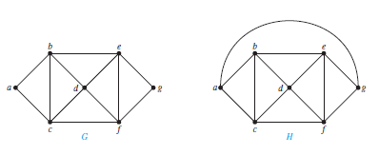
Example 1
Example 1: What are the chromatic numbers of the graphs G and H? [ We have done for the first graph in the last slide]

Slide 29
Solution of Example 1
Solution: (G) = 3; (H) = 4
G
H

Slide 30
An Application of Graph Coloring: Scheduling Final Exams at a university
How can the final exams at a university be scheduled so that no student has two exams at the same time?
Solution: This scheduling problem can be solved using a graph model, with vertices representing courses and with an edge between two vertices if there is a common student in the courses they represent. Each time slot for a final exam is represented by a different color.
A scheduling of the exams corresponds to a coloring of the associated graph.
30

Slide 31
Example 5: Scheduling Final Exam
Suppose there are seven finals to be scheduled. Suppose that the following pairs of courses have common students: 1 and 2, 1 and 3, 1 and 4, 1 and 7, 2 and 3, 2 and 4, 2 and 5, 2 and 7, 3 and 4, 3 and 6,
3 and 7, 4 and 5, 4 and 6, 5 and 6, 5 and 7, and 6 and 7.
How the final exams can be scheduled so that no
student has two exams at the same time?
31

Slide 32
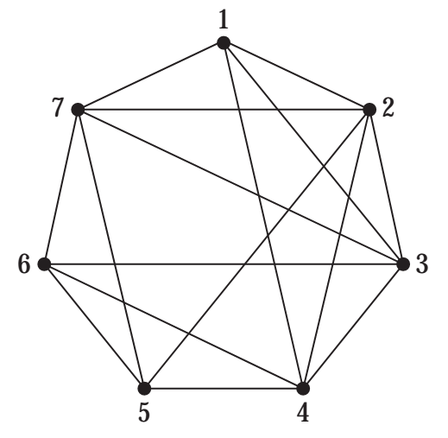
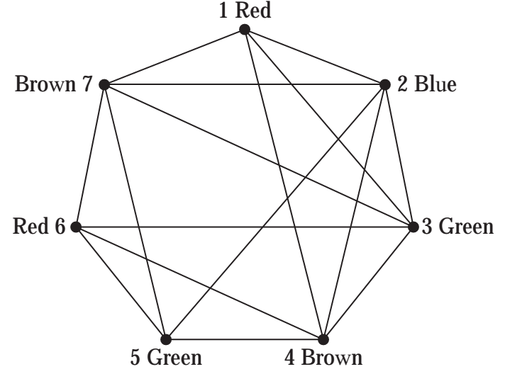
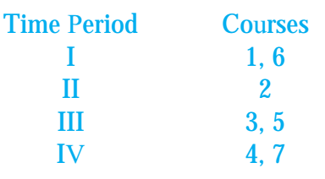
Solution
Because the chromatic number of this graph is 4, four time slots are needed.
32

Slide 33
Books
Rosen, K. H., & Krithivasan, K. (2012). Discrete mathematics and its applications: with combinatorics and graph theory. Tata McGraw-Hill Education. (7th Edition)

Slide 34
References
Discrete Mathematics, Richard Johnsonbaugh, Pearson education, Inc.
Discrete Mathematical Structures, Bernard Kolman, Robert C. Busby, Sharon Ross, Prentice-Hall, Inc.
SCHAUM’S outlines Discrete Mathematics(2nd edition), by Seymour Lipschutz, Marc Lipson
Simon Fraser University
https://www.cs.sfu.ca/~ggbaker/zju/math/planar.html
Discrete Mathematics: An Open Introduction, 3rd edition Oscar Levin
http://discrete.openmathbooks.org/dmoi3/sec_planar.html

